Slide 1
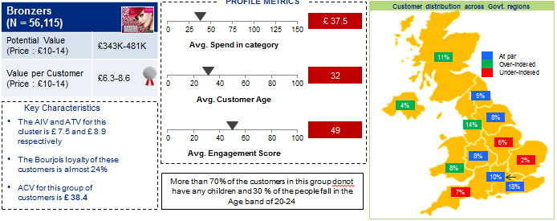
Mu Sigma enabled large retailer to identify key parameters for launch of new product based on loyalty card data
New product launch
Background
Insights/Recommendations
Mu Sigma recommended most preferred customer segments for a new product launch in the category
Customer segments were profiled to identify early adaptors and brand loyalists for targeting
Geographic profiling of customers helped provide insights on regions that have preference to tanning products
The client is one of the largest European Health and beauty retailers who has a loyalty card program for the past 17 years
The client wants to monetize their existing loyalty card data by providing insights to various of suppliers
The supplier in the tanning category wants to launch a new product in the market, to improve their presence in a certain category
Analytical Approach
Overall category was analyzed to identify sub category which is most viable to launch a new product
Exploratory data analysis was done to identify most preferred customer in tanning sub categories
Customer behavior was analyzed to identify segments for opportunity areas to target customers for the new product launch
Business Impact
The Supplier was able to arrive on a decision to launch a new product in the Tanning category and its form
Analysis provided supplier with platform to launch campaigns for the upcoming product launch, targeting certain customer segments

